Slide 1
Lecture 7: Optimization methods

Slide 2
Overview
Introduction
Mathematical formulation
One-dimensional minimization
Newton’s Method
Genetic algorithm

Slide 3


Introduction
Optimization is used everywhere in nature:
Physics
Chemistry
Economics
Engineering
Etc…
and of course STATISTICS!

Slide 4

Introduction
Example 1: Industry
How to produce a cylindrical beer can 0.5L so it requires minimum material?
Continuous optimization

Slide 5


Introduction
Example 2: Economics
Factories F1, F2
Retail outlets R1, R2, R3
Cost of shipping a product c_{ij}
Production a_{i} each week
Requirement b_{j} each week
F1
F2

Slide 6
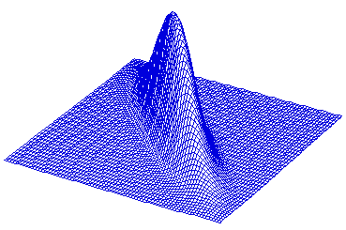
Introduction
Example 3: Statistics
Maximize Likelihood L(X, θ)

Slide 7
Maximum likelihood
Consider a sample (X₁, ..., X_{n}) which is drawn from a probability distribution P(X|Θ) where Θ are parameters.
If the Xs are independent with probability density function P(X_{i}|Θ) then the joint probability of the whole set is
Find the parameters that maximize this function
Consider a sample (X₁, ..., X_{n}) which is drawn from a probability distribution P(X|A) where A are parameters.
If the Xs are independent with probability density function P(X_{i}|A) the joint probability of the whole set is

Slide 8
Mathematical formulation
We need to minimize or maximize
Objective function f(x) (I - cost, II - profit, III-likelihood)
dependent on
Parameters or Unknowns x (I-height & diameter, II- supply, III – parameters

Slide 9
Mathematical formulation
Sometimes we have constraints c_{i}(x) satisfying equations or inequalities. Formulation:
What if:
Max instead of min
Constraints are not like these

Slide 10
Mathematical formulation
Example 1: Constraints – volume=0.5L
Example 2- cont.
Example 3 – no constraints UNCONSTRAINED MINIMIZATION

Slide 11
Where we are
Why different algorithms?
Speed
Memory
Historically
Unconstrained
Optimization
Constrained
Steepest descent
Newton method
Quasi-Newton-Methods
Conjugate gradients

Slide 12
One-dimensional minimization
One-dimensional minimization=one parameter
Algorithm Golden Section: finds local minimum on interval [A,B]
It narrows down the search interval, constant reduction factor 1-α=(√5 -1 )/2≈0.62

Slide 13
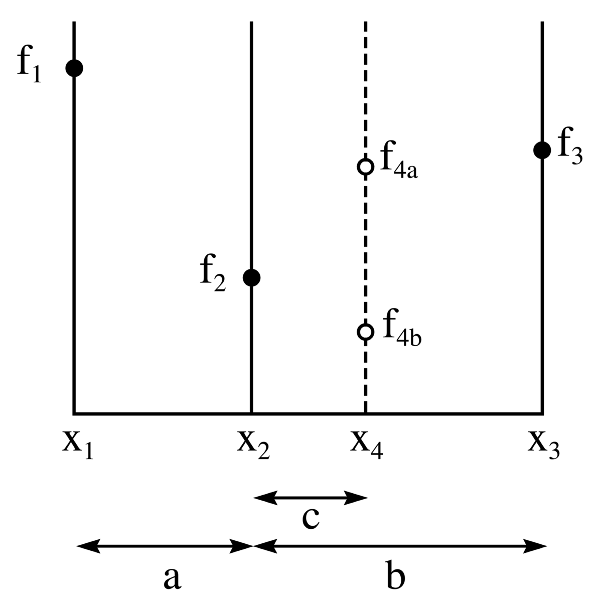
One-dimensional minimization
Golden section
Choose interval [x₁, x₃]
Choose a=α(x₃ – x₁)
x₂=x₁+a, x₄=x₃-a
If f₄>f₂ select RED
If f₄<f₂ select BLUE
Continue with new interval until it is small
_{Note: f should be unimodal}

Slide 14
R: One-dimensional minimization
Brent’s method – improved golden search
optimize(f, interval,...)

Slide 15
Multidimensional optimization
General methodology:
Given starting point x₀, x=x₀
Choose direction p and step α
Move to x:=x+ α p
Repeat from 2 until convergence
The problem:
Gradient
Hessian

Slide 16
Multidimensional optimization
How to choose direction leading to function decrease ?
Taylor theorem
The minimum is
Any direction having is descent direction
Should be minimized

Slide 17
Multidimensional optimization
How to choose step size α?
Find global minimum along direction p (expensive)
Find a sufficient decrease
BACKTRACKING
Choose α₀ >0, ρ in (0,1), c in (0,1), α:= α₀
REPEAT until f(x_{k}+ αp_{k}) ≤ f(x_{k}) +c α▼f_{k}^{T}(p_{k})
α:= ρ α
END

Slide 18
Newton’s method
In statistics called Newton-Raphson method
General idea:
Quadratic model
Minimum
When general function,
Tailor expansion
Proceed to next point
x:=x+αp

Slide 19
Newton’s method
Illustration:
Steepest descent
Newton’s direction

Slide 20
Newton’s method
Comments
Under mild conditions: Converges quickly, especially near optimum
For p to be a descent direction Hessian should be positive definite (see why)–strong requirement!
Can be very expensive to compute reverse of Hessian on each iteration!
Need to store n*n matrix (Hessian) – memory requirements

Slide 21
Quasi-Newton methods
Idea:
In Newton’s method instead computing inverse of Hessian on each step
Compute approximate Hessian B_{k} and reverse H_{k}
BFGS: Using knowledge about H_{k}, function and gradient in x_{k} and x_{k+1}, compute H_{k+1}

Slide 22
BFGS
Comments
Typically takes more iterations than Newton’s method
Each iteration takes less time (no matrix inversion!)
Quasi-Newton Methods are particularly good for large-scale problems.
How to choose initial Hessian?

Slide 23
R: Multidimensional optimization
Quasi-Newton and CG incorporated in one procedure
optim(par, fn, gr=Null, method, ...)
Look also
nls(...)

Slide 24
Stochastic and combinatorial optimization
Assumed before:
Input variables are continuous
Response is differentiable
We could apply Steepest descent, Newton, BFGS, CG
Now:
Variables can be discrete (scheduling problem, traveling salesman)
Outcome can be discrete, noisy (typical in statistics) or having multiple local minima

Slide 25
Stochastic and combinatorial optimization
Given set of states S, objective to minimize f(s), typically S is large.
Sometimes, exhaustive search is possible (shortest path algorithm)
Often exhaustive search is computationally expensive, sometimes NP-hard (traveling salesman)
Alternative – a solution (sometimes exact) can be obtained by stochastic methods (ex: simulated annealing, genetic algorithms)

Slide 26
Genetic algorithm
Idea comes from biology (the fittest survives)
Variables=genotypes
Observation=organism, characterized by genetic code
State space= Population of organisms
Objective function=fitness of organism
New points are obtained from old points by crossover and mutation, the population retains only fittest organisms (with better objective function)

Slide 27
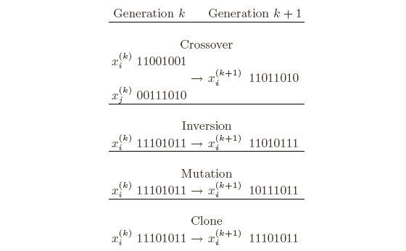
Genetic algorithm
How to code the points
Enumerate each point in S
Code for observation i is presented by binary representation of i
Other encodings are possible
Mutation and recombination rules

Slide 28
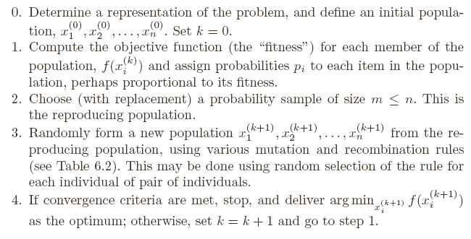
Genetic algorithm

Slide 29
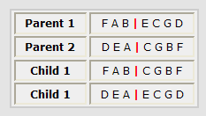
Genetic algorithm
Traveling salesman problem
Encoding and crossover
First idea - encode tours as A₁…A_{n.} Problem:
Instead: Remove FAB from DEACGBF -> DECG. Obtain first child by appending: FABDECG
Second child is obtained by taking prefix from parent 2

Slide 30
Genetic algorithm
Traveling salesman problem
Mutation
If taking small population and using only crossover – the input domain becomes limited, may converge to local solution
Taking large initial population may be computationally heavy
Mutation allows to investigate entire input domain
In traveling salesman, mutation =moving a city in the tour to another position

Slide 31
Genetic algorithm
Traveling salesman problem
Other issues
Reproduction: Among m tours selected at step 2, two best are selected for reproduction, two worst replaced by children
Neighborhood size: large m – some tours are never parents, global solution may not be attained
Mutation probalility should be fixed

Slide 32
Reading
Book, Chapter 6

